Slide 2
Deep Dive: KWOK
Shiming Zhang (DaoCloud) & Hao Liang (Tencent)
Notes:
自我介绍

Slide 3
What is KWOK?

Slide 4
What is KWOK ?
KWOK

Slide 5
What is KWOK ?
Kubernetes WithOut Kubelet

Slide 6
What is KWOK ?
KWOK

Slide 7
What is KWOK ?
KWOK

Slide 8

What is KWOK ?

Slide 9

What is KWOK ?
kwok (kwok-controller)
kwokctl
Notes:
KWOK 项目当前主要两个工具
kwok 负责维护 Node/Pod 资源, 和提供 Kubelet 的接口
Kwokctl 负责组合 kwok 和 k8s 的控制面组件

Slide 10

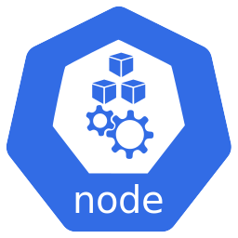

What is kwok ?
Control Plane
Node Resource
Machine/Kubelet
Machine
Notes:
在普通k8s集群中，由控制面组件+node组成
节点通过kubelet进程往apiserver注册node资源
Pod被调度到真实的node上，节点上运行真实的容器进程

Slide 11
What is kwok ?
Node Resource Addition
Machine/Kubelet Addition
Machine
Machine
Notes:
集群中想要增加1个 Node，需要在新的机器上对应启动一个kubelet进程

Slide 12
What is kwok ?
Multiple Node Resource
Multiple Machine/Kubelet
Machine
Machine
Machine
Notes:
集群中想要增加多个 Node
对应准备多个真实机器
运行Kubelet进程进行新节点注册

Slide 13
What is kwok ?
Simulate kubelet by kwok-controller
Notes:
Kwok本质上实现了一些controller的逻辑
用于模拟 kubelet 的行为

Slide 14
What is kwok ?
Node/Pod resource lifecycle management
Notes:
它的作用和kubelet类似，去维持Node和Pod资源的生命周期

Slide 15
What is kwok ?
Node/Pod resource lifecycle management
No machine and kubelet needed, No Pod container running
Notes:
但并不会在真实节点上运行真实的容器，也就不需要准备真实的机器，不需要启动kubelet进程

Slide 16
What is kwok ?
Node/Pod resource lifecycle management
No machine and kubelet needed, No Pod container running
Manage multiple Node/Pod resource in one kwok process
Notes:
多个 Node 和上面的多个 Pod资源只需要一个kwok进程进行维护

Slide 17
What is kwok ?
Lifecycle Controller
Pod
Node
Node Lease
...
...
Notes:
总的来说，kwok主要由 2 部分构成：
首先它实现了一系列的控制器：Pod、Node、NodeLease controller，通过控制器去模拟kubelet管理Node/Pod的生命周期
不仅仅可以模拟正常Pod/Node的状态流程
也可以通过crd去自定义pod/node的状态
可以做故障模拟

Slide 18
What is kwok ?
Customize Pod Status:
Pending
ContainerCreating
Running
Terminating
...
Lifecycle Controller
Pod
Node
Node Lease
...
...
Notes:
总的来说，kwok主要由 2 部分构成：
首先它实现了一系列的控制器：Pod、Node、NodeLease controller，通过控制器去模拟kubelet管理Node/Pod的生命周期

Slide 19
What is kwok ?
Customize Node Status:
NotReady
Ready
...
Lifecycle Controller
Pod
Node
Node Lease
...
...
Notes:
总的来说，kwok主要由 2 部分构成：
首先它实现了一系列的控制器：Pod、Node、NodeLease controller，通过控制器去模拟kubelet管理Node/Pod的生命周期

Slide 20
What is kwok ?
Fault Injection and simulation
...
Lifecycle Controller
Pod
Node
Node Lease
...
...
Notes:
总的来说，kwok主要由 2 部分构成：
首先它实现了一系列的控制器：Pod、Node、NodeLease controller，通过控制器去模拟kubelet管理Node/Pod的生命周期

Slide 21
What is kwok ?
Lifecycle Controller
Pod
Node
Node Lease
...
...
Kubelet Server Simulation
Metrics
Exec
Log
Attach
Port-forward
Notes:
其次是作为服务端，模拟 Kubelet 暴露给 APiserver 的服务：Metrics接口的实现、exec、logs、attach、port-forward等功能的实现

Slide 22
What is kwok ?
...
...
As close as possible to the kubelet
Low resource consumption
Numerous Nodes and Pods scaling simulation
Performance test for control plane
Notes:
总的来说，kwok尽可能地把kubelet的各种功能模拟了出来
支持大规模 Node 和 Pod扩缩容场景的模拟
并且整个过程中对的资源消耗是非常小的
特别适用于一些控制面组件的性能压力测试的场景

Slide 23
What is KWOK ?
kwok (kwok-controller)
kwokctl
Notes:
KWOK 项目当前主要两个工具
kwok 负责维护 Node/Pod 资源, 和提供 Kubelet 的接口
Kwokctl 负责组合 kwok 和 k8s 的控制面组件

Slide 24

Introduce
kwokctl
Notes:
演示kwokctl的创建k8s集群的功能，只需要通过一条简单的kwokctl create cluster命令就能几秒钟创建一个k8s集群

Slide 25
What is kwokctl ?
Cluster
Notes:
有些情况下我们想直接模拟集群

Slide 26



What is kwokctl ?
Cluster
Notes:
通过kwokctl可以指定以上控制面组件的运行形态

Slide 27
What is kwokctl ?
Host (Workstation)
Cluster
Notes:
通过kwokctl可以指定以上控制面组件的运行形态

Slide 28
What is kwokctl ?
Host (Workstation)
Cluster
Runtime
>_
kwokctl
binary
$ kwokctl create cluster –name kwok --runtime binary
Notes:
指定使用二进制启动集群

Slide 29


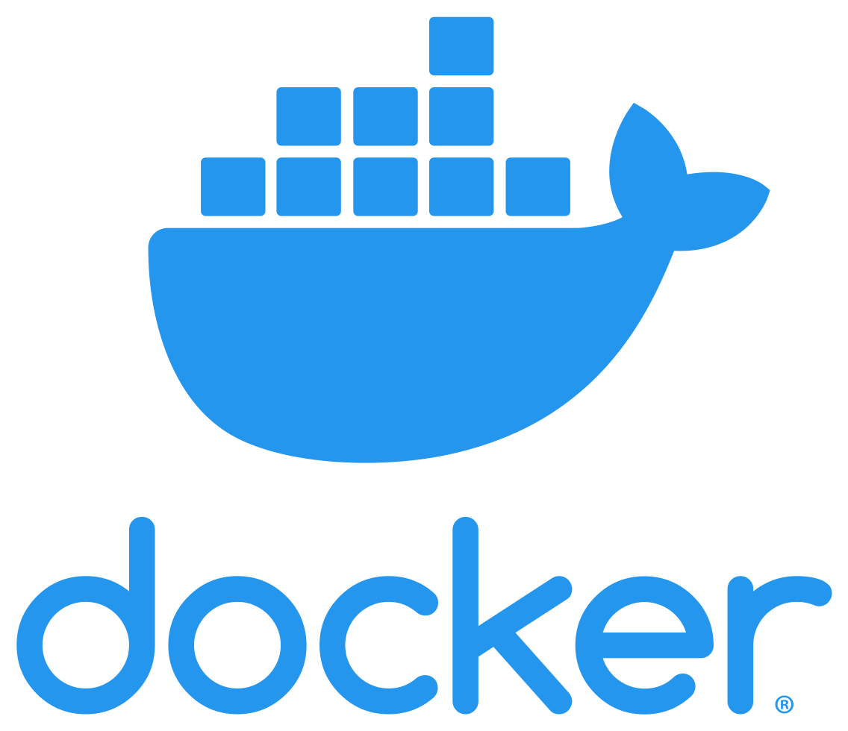
What is kwokctl ?
Host (Workstation)
Cluster
Runtime
kwokctl
$ kwokctl create cluster –name kwok --runtime docker
Notes:
指定使用容器启动集群

Slide 30
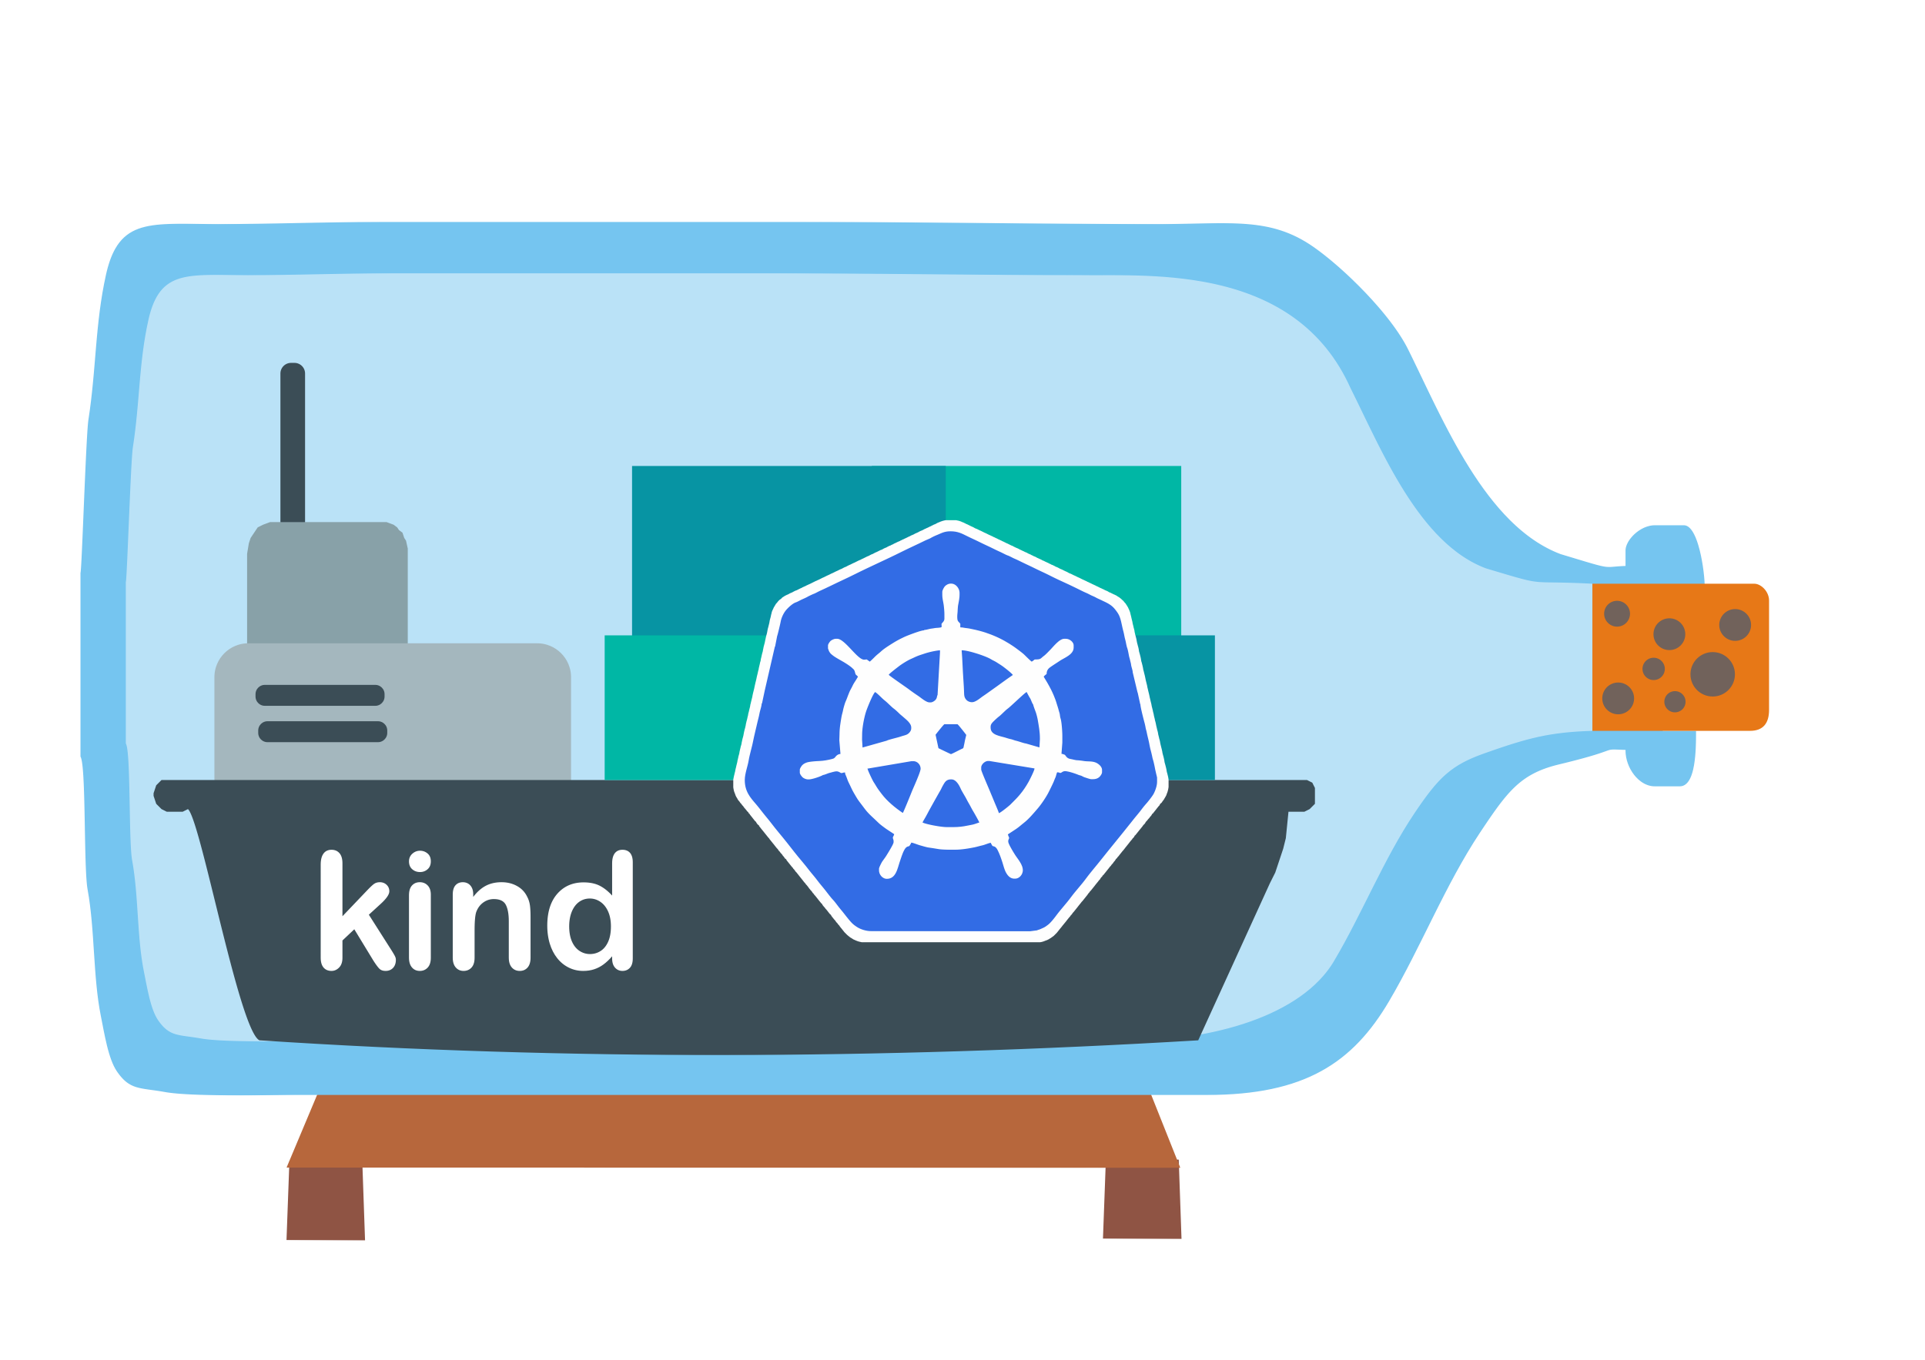
What is kwokctl ?
Host (Workstation)
Cluster
Runtime
kwokctl
$ kwokctl create cluster –name kwok --runtime kind
Notes:
指定使用容器启动集群

Slide 31
What is kwokctl ?
Host (Workstation)
Cluster
Runtime
>_
kwokctl
binary
Notes:
kwokctl 本质上是一个组合各个组件使其成为一个集群的工具

Slide 32
What is kwokctl ?
Host (Workstation)
Cluster
Runtime
>_
kwokctl
binary
$ kwokctl create cluster --kube-scheduler-binary=xxx
$ kwokctl create cluster --kube-scheduler-image=xxx
Notes:
kwokctl 本质上是一个组合各个组件使其成为一个集群的工具

Slide 33
What is kwokctl ?
Host (Workstation)
Cluster
Runtime
>_
kwokctl
binary
$ kwokctl create cluster --disable-kube-scheduler
Notes:
kwokctl 本质上是一个组合各个组件使其成为一个集群的工具

Slide 34
What is kwokctl ?
Host (Workstation)
Command tools
Cluster
Easy to use
Runtime
>_
kwokctl
binary
Notes:
kwokctl 本质上是一个组合各个组件使其成为一个集群的工具

Slide 35



What is kwokctl ?
Host (Workstation)
Command tools
Cluster
Easy to use
Cross platform
Runtime
>_
kwokctl
binary
Notes:
kwokctl 本质上是一个组合各个组件使其成为一个集群的工具

Slide 36
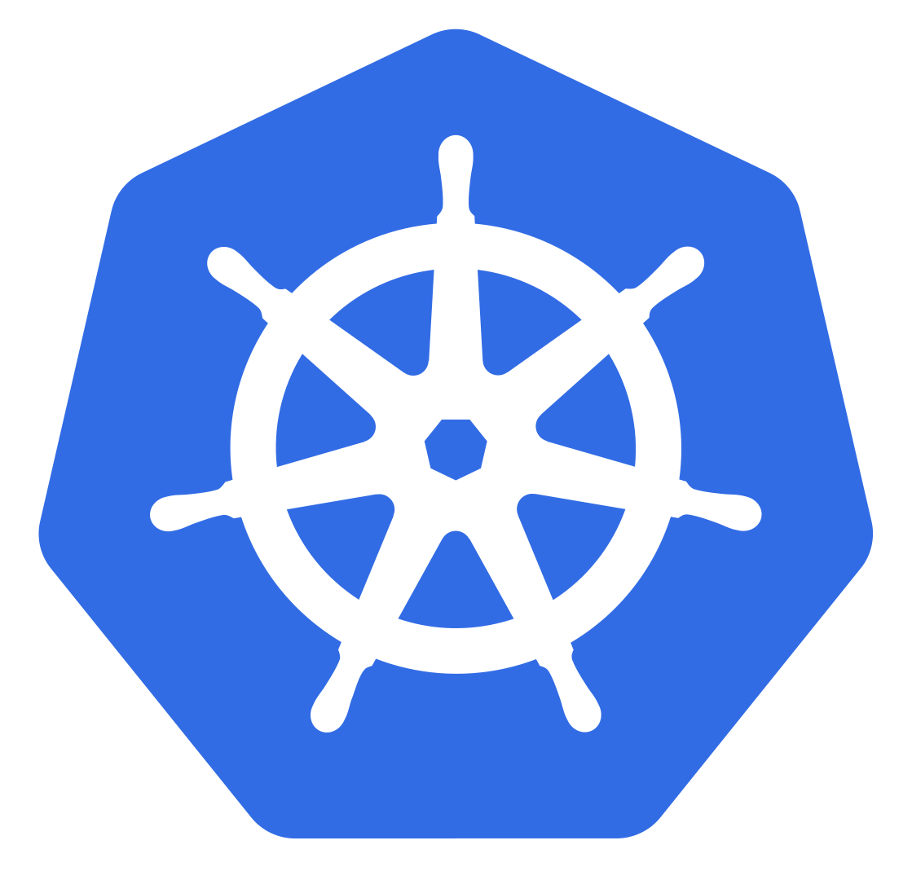
What is kwokctl ?
Host (Workstation)
Command tools
Cluster
Easy to use
Cross platform
kubectl
kubectl
Runtime
>_
kwokctl
binary
Notes:
kwokctl 本质上是一个组合各个组件使其成为一个集群的工具

Slide 37
What is kwokctl ?
Host (Workstation)
Command tools
Cluster
Easy to use
Cross platform
kubectl
kubectl
$ kwokctl kubectl
Runtime
>_
kwokctl
binary
Notes:
kwokctl 本质上是一个组合各个组件使其成为一个集群的工具

Slide 38

What is kwokctl ?
Host (Workstation)
Command tools
Cluster
Easy to use
Cross platform
kubectl
etcdctl
Snapshot
etcdctl
kubectl
Runtime
>_
kwokctl
binary
Notes:
kwokctl 本质上是一个组合各个组件使其成为一个集群的工具

Slide 39
What is kwokctl ?
Host (Workstation)
Command tools
Cluster
Easy to use
Cross platform
kubectl
etcdctl
Snapshot
etcdctl
$ kwokctl etcdctl
kubectl
Runtime
>_
kwokctl
binary
Notes:
kwokctl 本质上是一个组合各个组件使其成为一个集群的工具

Slide 40

What is kwokctl ?
Host (Workstation)
Command tools
Easy to use
Cross platform
kubectl
etcdctl
Snapshot
Metrics
Cluster
etcdctl
kubectl
Runtime
>_
kwokctl
binary
Notes:
kwokctl 本质上是一个组合各个组件使其成为一个集群的工具

Slide 41
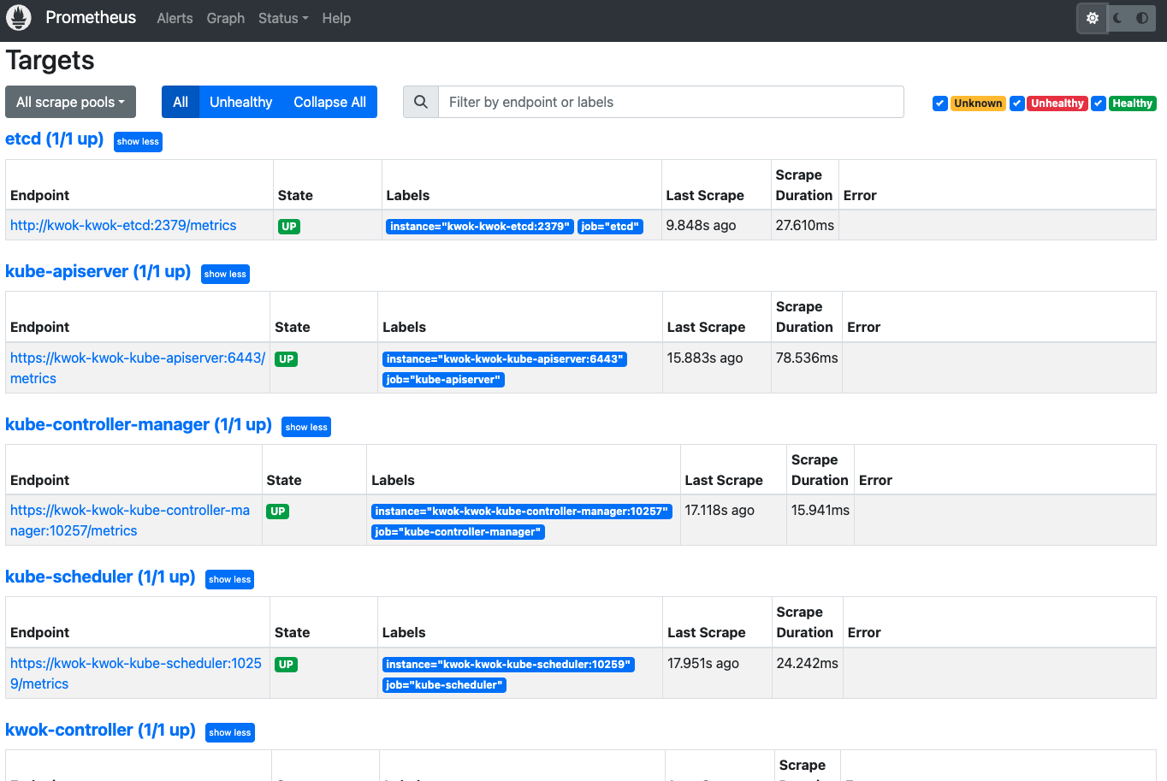
What is kwokctl ?
Host (Workstation)
Command tools
Easy to use
Cross platform
kubectl
etcdctl
Snapshot
Metrics
Cluster
etcdctl
kubectl
Runtime
>_
kwokctl
binary
$ kwokctl create cluster --prometheuis-port 8080
Notes:
kwokctl 本质上是一个组合各个组件使其成为一个集群的工具

Slide 42

What is kwokctl ?
Host (Workstation)
Easy to use
Cross platform
kubectl
etcdctl
Snapshot
Metrics
Tracing
Command tools
Cluster
etcdctl
kubectl
Runtime
>_
kwokctl
binary
Notes:
kwokctl 本质上是一个组合各个组件使其成为一个集群的工具

Slide 43
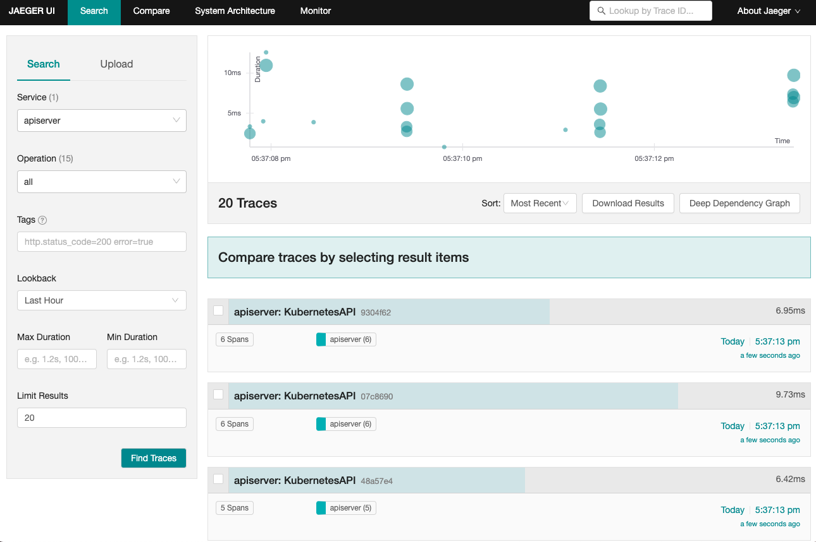
What is kwokctl ?
Host (Workstation)
Easy to use
Cross platform
kubectl
etcdctl
Snapshot
Metrics
Tracing
Command tools
Cluster
etcdctl
kubectl
Runtime
>_
kwokctl
binary
$ kwokctl create cluster --jaeger-port 8080
Notes:
kwokctl 本质上是一个组合各个组件使其成为一个集群的工具

Slide 44
What is kwokctl ?
Host (Workstation)
Command tools
Cluster
etcdctl
kubectl
Runtime
>_
kwokctl
binary
Notes:
kwokctl 本质上是一个组合各个组件使其成为一个集群的工具

Slide 45
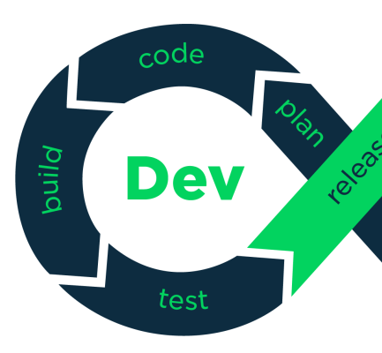
Why/How to Use KWOK?
Notes:
kwok能满足哪些需求
怎么去使用kwok

Slide 46
Why/How to Use KWOK?
Local Development​
Test & CI Pipeline​
Performance​
Notes:
kwok 本质上一个开发时的工具主要有这些场景 本地开发和调试 e2e 测试和集成进 CI
控制面的性能测试

Slide 47
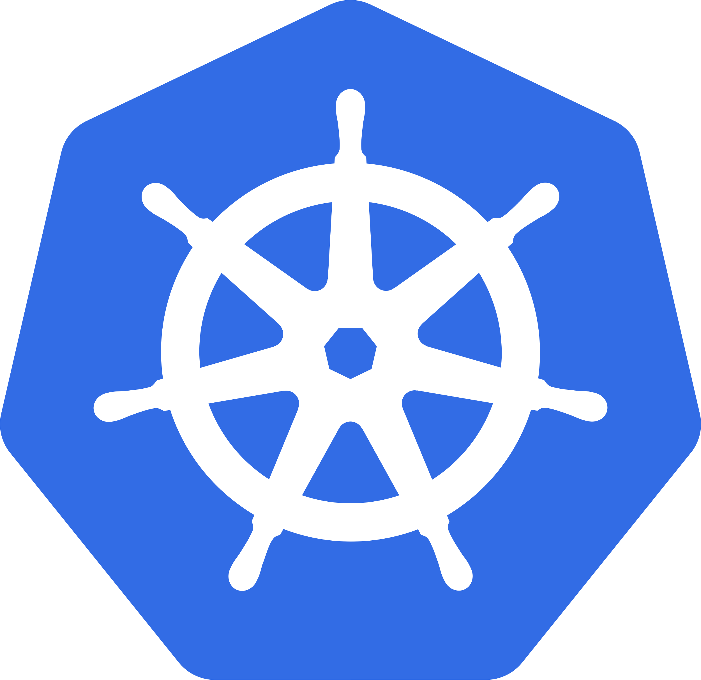

Local Development
Reproduction of Production Issues
Something went wrong in Production Cluster
Directly troubleshooting in Production could be risky
Hard to reproduce the issues in Production
Snapshot save
kwokctl
Production Cluster
How to reproduce and debug Production issues ?
Notes:
生产环境问题复现：当生产环境遇到问题需要保留现场、不方便及时排查时，kwokctl快照功能将生产k8s环境做快照，导入到本地k8s环境进行反复地复现、排查

Slide 48
Local Development
Reproduction of Production Issues
Cluster Snapshot
Notes:
生产环境问题复现：当生产环境遇到问题需要保留现场、不方便及时排查时，kwokctl快照功能将生产k8s环境做快照，导入到本地k8s环境进行反复地复现、排查

Slide 49
Local Development
Reproduction of Production Issues
kwokctl
Create cluster
Cluster
kwok cluster
Notes:
生产环境问题复现：当生产环境遇到问题需要保留现场、不方便及时排查时，kwokctl快照功能将生产k8s环境做快照，导入到本地k8s环境进行反复地复现、排查

Slide 50
Local Development
Reproduction of Production Issues
Cluster
kwok cluster
Notes:
生产环境问题复现：当生产环境遇到问题需要保留现场、不方便及时排查时，kwokctl快照功能将生产k8s环境做快照，导入到本地k8s环境进行反复地复现、排查

Slide 51
Local Development
Reproduction of Production Issues
Cluster
Snapshot restore
kwokctl
kwok cluster
Notes:
生产环境问题复现：当生产环境遇到问题需要保留现场、不方便及时排查时，kwokctl快照功能将生产k8s环境做快照，导入到本地k8s环境进行反复地复现、排查

Slide 52
Local Development
Reproduction of Production Issues
Local kwok cluster with production data
Directly troubleshooting in Local cluster
Reproduce the issues in one click
Cluster
How to debug code locally?
kwok cluster with production data
Notes:
生产环境问题复现：当生产环境遇到问题需要保留现场、不方便及时排查时，kwokctl快照功能将生产k8s环境做快照，导入到本地k8s环境进行反复地复现、排查

Slide 53


Local Development
Code development and debug
Start a custom component in IDE Locally
Local IDE connects to the Local cluster with production data
Debug in IDE directly
Cluster
Now we can reproduce and debug production issues locally
Local IDE
kwok cluster with production data
Notes:
在本地启动IDE，打开问题组件的代码
Debug模式启动组件，直接连接带有生产环境数据的本地kwok集群
直接在IDE中进行断点debug
现在我们通过kwok不仅仅能在本地方便地去复现生产环境的问题
还能在本地直接对生产环境的组件进行debug

Slide 54
Why/How to Use KWOK?
Local Development​
Test & CI Pipeline​
Performance​
Notes:
kwok 本质上一个开发时的工具主要有这些场景 本地开发和调试 e2e 测试和集成进 CI
控制面的性能测试

Slide 55


Test & CI Pipeline
e2e
Integration
Unit
$$$
$
Notes:
比较有优势的场景
多集群
Node 或 Pod 较多的场景

Slide 56
Test & CI Pipeline
e2e with
Integration
Unit
e2e
$$$
$
Notes:
比较有优势的场景
多集群
Node 或 Pod 较多的场景

Slide 57
Test & CI Pipeline
import ( "os" "testing"
"sigs.k8s.io/e2e-framework/pkg/env" "sigs.k8s.io/e2e-framework/pkg/envconf" "sigs.k8s.io/e2e-framework/pkg/envfuncs" "sigs.k8s.io/e2e-framework/support/kwok" ) var testenv env.Environment func TestMain(m *testing.M) { testenv = env.New() clusterName := envconf.RandomName("kwok-cluster", 16) namespace := envconf.RandomName("kwok-ns", 16) testenv.Setup( envfuncs.CreateCluster(kwok.NewProvider(), clusterName), envfuncs.CreateNamespace(namespace), ) testenv.Finish( envfuncs.DestroyCluster(clusterName), ) os.Exit(testenv.Run(m)) }
sigs.k8s.io/e2e-framework
Notes:
组件开发集成e2e测试：
使用k8s-sig提供的e2ef-framework测试框架

Slide 58
Test & CI Pipeline
import ( "os" "testing"
"sigs.k8s.io/e2e-framework/pkg/env" "sigs.k8s.io/e2e-framework/pkg/envconf" "sigs.k8s.io/e2e-framework/pkg/envfuncs" "sigs.k8s.io/e2e-framework/support/kwok" ) var testenv env.Environment func TestMain(m *testing.M) { testenv = env.New() clusterName := envconf.RandomName("kwok-cluster", 16) namespace := envconf.RandomName("kwok-ns", 16) testenv.Setup( envfuncs.CreateCluster(kwok.NewProvider(), clusterName), envfuncs.CreateNamespace(namespace), ) testenv.Finish( envfuncs.DestroyCluster(clusterName), ) os.Exit(testenv.Run(m)) }
sigs.k8s.io/e2e-framework
Notes:
组件开发集成e2e测试：
使用k8s-sig提供的e2ef-framework测试框架

Slide 59
Test & CI Pipeline
import ( "os" "testing"
"sigs.k8s.io/e2e-framework/pkg/env" "sigs.k8s.io/e2e-framework/pkg/envconf" "sigs.k8s.io/e2e-framework/pkg/envfuncs" "sigs.k8s.io/e2e-framework/support/kwok" ) var testenv env.Environment func TestMain(m *testing.M) { testenv = env.New() clusterName := envconf.RandomName("kwok-cluster", 16) namespace := envconf.RandomName("kwok-ns", 16) testenv.Setup( envfuncs.CreateCluster(kwok.NewProvider(), clusterName), envfuncs.CreateNamespace(namespace), ) testenv.Finish( envfuncs.DestroyCluster(clusterName), ) os.Exit(testenv.Run(m)) }
func TestKwokCluster(t *testing.T) { deploymentFeature := features.New("cases"). Setup(func(ctx context.Context, t *testing.T, cfg *envconf.Config) context.Context { node := newNode("kwok-node") if err := cfg.Client().Resources().Create(ctx, node); err != nil { t.Fatal(err) } deployment := newDeployment(cfg.Namespace(), "test-deployment", 1) if err := cfg.Client().Resources().Create(ctx, deployment); err != nil { t.Fatal(err) } return ctx }). Assess("test case", func(ctx context.Context, t *testing.T, cfg *envconf.Config) context.Context { // TODO: add test case return ctx }, ). Feature() testenv.Test(t, deploymentFeature) }
sigs.k8s.io/e2e-framework
Notes:
组件开发集成e2e测试：
使用k8s-sig提供的e2ef-framework测试框架

Slide 60
Test & CI Pipeline
import ( "os" "testing"
"sigs.k8s.io/e2e-framework/pkg/env" "sigs.k8s.io/e2e-framework/pkg/envconf" "sigs.k8s.io/e2e-framework/pkg/envfuncs" "sigs.k8s.io/e2e-framework/support/kwok" ) var testenv env.Environment func TestMain(m *testing.M) { testenv = env.New() clusterName := envconf.RandomName("kwok-cluster", 16) namespace := envconf.RandomName("kwok-ns", 16) testenv.Setup( envfuncs.CreateCluster(kwok.NewProvider(), clusterName), envfuncs.CreateNamespace(namespace), ) testenv.Finish( envfuncs.DestroyCluster(clusterName), ) os.Exit(testenv.Run(m)) }
func TestKwokCluster(t *testing.T) { deploymentFeature := features.New("cases"). Setup(func(ctx context.Context, t *testing.T, cfg *envconf.Config) context.Context { node := newNode("kwok-node") if err := cfg.Client().Resources().Create(ctx, node); err != nil { t.Fatal(err) } deployment := newDeployment(cfg.Namespace(), "test-deployment", 1) if err := cfg.Client().Resources().Create(ctx, deployment); err != nil { t.Fatal(err) } return ctx }). Assess("test case", func(ctx context.Context, t *testing.T, cfg *envconf.Config) context.Context { // TODO: add test case return ctx }, ). Feature() testenv.Test(t, deploymentFeature) }
sigs.k8s.io/e2e-framework
Notes:
组件开发集成e2e测试：
使用k8s-sig提供的e2ef-framework测试框架

Slide 61
Test & CI Pipeline
import ( "os" "testing"
"sigs.k8s.io/e2e-framework/pkg/env" "sigs.k8s.io/e2e-framework/pkg/envconf" "sigs.k8s.io/e2e-framework/pkg/envfuncs" "sigs.k8s.io/e2e-framework/support/kwok" ) var testenv env.Environment func TestMain(m *testing.M) { testenv = env.New() clusterName := envconf.RandomName("kwok-cluster", 16) namespace := envconf.RandomName("kwok-ns", 16) testenv.Setup( envfuncs.CreateCluster(kwok.NewProvider(), clusterName), envfuncs.CreateNamespace(namespace), ) testenv.Finish( envfuncs.DestroyCluster(clusterName), ) os.Exit(testenv.Run(m)) }
func TestKwokCluster(t *testing.T) { deploymentFeature := features.New("cases"). Setup(func(ctx context.Context, t *testing.T, cfg *envconf.Config) context.Context { node := newNode("kwok-node") if err := cfg.Client().Resources().Create(ctx, node); err != nil { t.Fatal(err) } deployment := newDeployment(cfg.Namespace(), "test-deployment", 1) if err := cfg.Client().Resources().Create(ctx, deployment); err != nil { t.Fatal(err) } return ctx }). Assess("test case", func(ctx context.Context, t *testing.T, cfg *envconf.Config) context.Context { // TODO: add test case return ctx }, ). Feature() testenv.Test(t, deploymentFeature) }
sigs.k8s.io/e2e-framework
Notes:
组件开发集成e2e测试：
使用k8s-sig提供的e2ef-framework测试框架

Slide 62
Test & CI Pipeline
import ( "os" "testing"
"sigs.k8s.io/e2e-framework/pkg/env" "sigs.k8s.io/e2e-framework/pkg/envconf" "sigs.k8s.io/e2e-framework/pkg/envfuncs" "sigs.k8s.io/e2e-framework/support/kwok" ) var testenv env.Environment func TestMain(m *testing.M) { testenv = env.New() clusterName := envconf.RandomName("kwok-cluster", 16) namespace := envconf.RandomName("kwok-ns", 16) testenv.Setup( envfuncs.CreateCluster(kwok.NewProvider(), clusterName), envfuncs.CreateNamespace(namespace), ) testenv.Finish( envfuncs.DestroyCluster(clusterName), ) os.Exit(testenv.Run(m)) }
func TestKwokCluster(t *testing.T) { deploymentFeature := features.New("cases"). Setup(func(ctx context.Context, t *testing.T, cfg *envconf.Config) context.Context { node := newNode("kwok-node") if err := cfg.Client().Resources().Create(ctx, node); err != nil { t.Fatal(err) } deployment := newDeployment(cfg.Namespace(), "test-deployment", 1) if err := cfg.Client().Resources().Create(ctx, deployment); err != nil { t.Fatal(err) } return ctx }). Assess("test case", func(ctx context.Context, t *testing.T, cfg *envconf.Config) context.Context { // TODO: add test case return ctx }, ). Feature() testenv.Test(t, deploymentFeature) }
sigs.k8s.io/e2e-framework
Notes:
组件开发集成e2e测试：
使用k8s-sig提供的e2ef-framework测试框架

Slide 63
Test & CI Pipeline
$ go test ./…
Notes:
组件开发集成e2e测试：
在CI pipline中使用kwokctl创建k8s集群，进行自动化e2e测试

Slide 64

Simulate pod behavior

Slide 65
Why/How to Use KWOK?
Local Development​
Test & CI Pipeline​
Performance​
Notes:
kwok 本质上一个开发时的工具主要有这些场景 本地开发和调试 e2e 测试和集成进 CI
控制面的性能测试

Slide 66
Performance
e.g. 5000 Nodes or 150,000 Pods
Speed
Capacity
Core
Apiserver
Etcd
Controller
Scheduler
Controller Manager
CRD/Operator
Notes:
K8s组件性能测试
快速创建大量node和pod
1、调度器调度时延
2、控制器处理性能
3、资源消耗
1、控制器压测
2、调度器压测

Slide 67

Performance

Slide 68
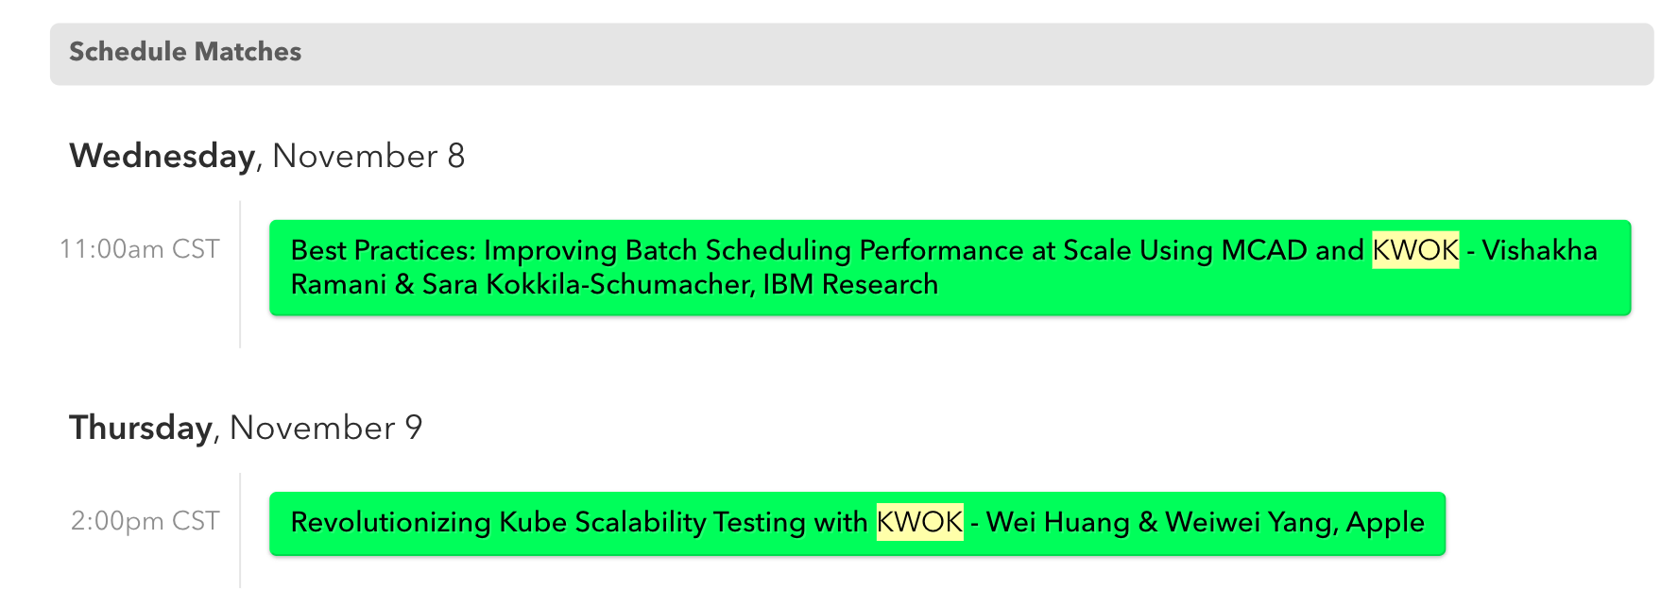
KubeCon NA 2023
https://kccncna2023.sched.com/?searchstring=KWOK

Slide 69
Roadmap
Simulate CPU/Memory Usage
Simulate Custom Metrics/External Metrics
e.g. GPU Usage
Make custom components and kwok clusters work together
e.g. Playground
Explore being part of Chao

Slide 70
Join us
#kwok on the Kubernetes slack.k8s.io
Repo: sigs.k8s.io/kwok
Docs: kwok.sigs.k8s.io

